Slide 1
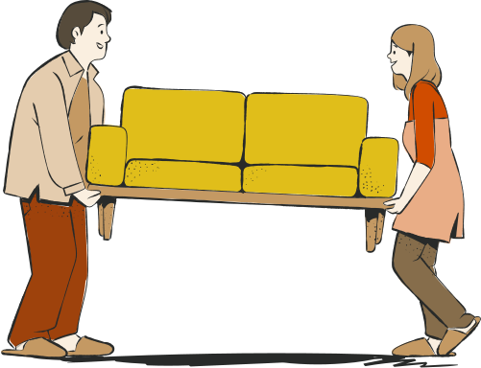
Thriftn’
buy smart , sell smart , thrift smart
Presented By:
Aiman Zahoor
Zainab Usama

Slide 2


Definition
Thrift store is a place for buying & selling old items.
Items are sold at lower price than their original retail value

Slide 3

The Problem
Economic challenges
Deceptive pricing
Underutilizing items
Excessive waste generation

Slide 4
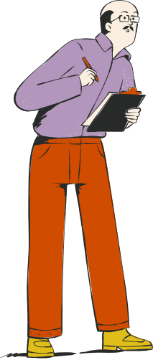
The current setup
Limited audience reach
Lack trusted sellers
Limited quality assurance
Scam risks
Crowded platforms

Slide 5

Research
Cultural tradition of sharing & giving
Rise of online thrift stores
Hesitancy in buying used items
Cost-saving
Environmental concerns

Slide 6

Literature review
Minimalist trend
Post-COVID sales boost
Green consumerism impact
Youth attraction

Slide 7
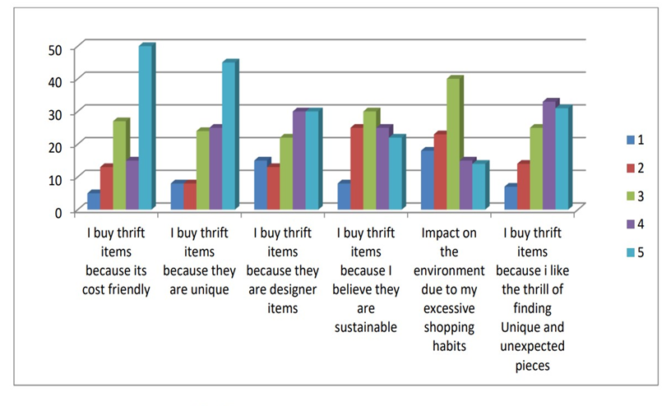
According to a study below are some factors that encourage the use of thrift stores

Slide 8


eBay
Big online market
Auction styles
Builds trust
Global accessibility
limitations on number of listings
Buyer centric return policies

Slide 9

The Fix
Goal :
creating a web application that allows people to buy and sell affordable second-hand items or donate items.

Slide 10
The Fix
helping those struggling with inflation and contribute to reducing waste
evolution of sharing tradition and
promoting social good

Slide 11
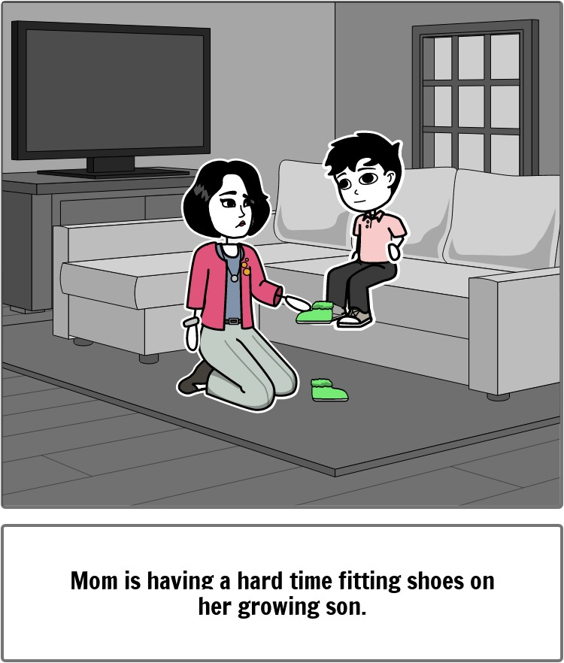
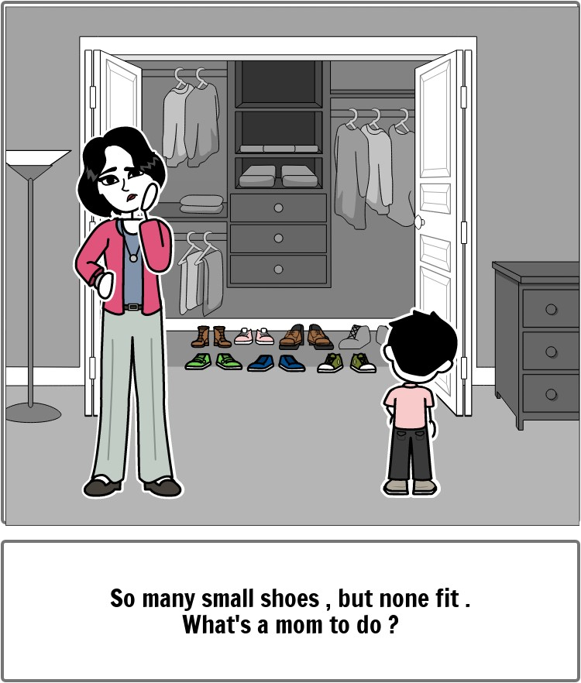

Slide 12
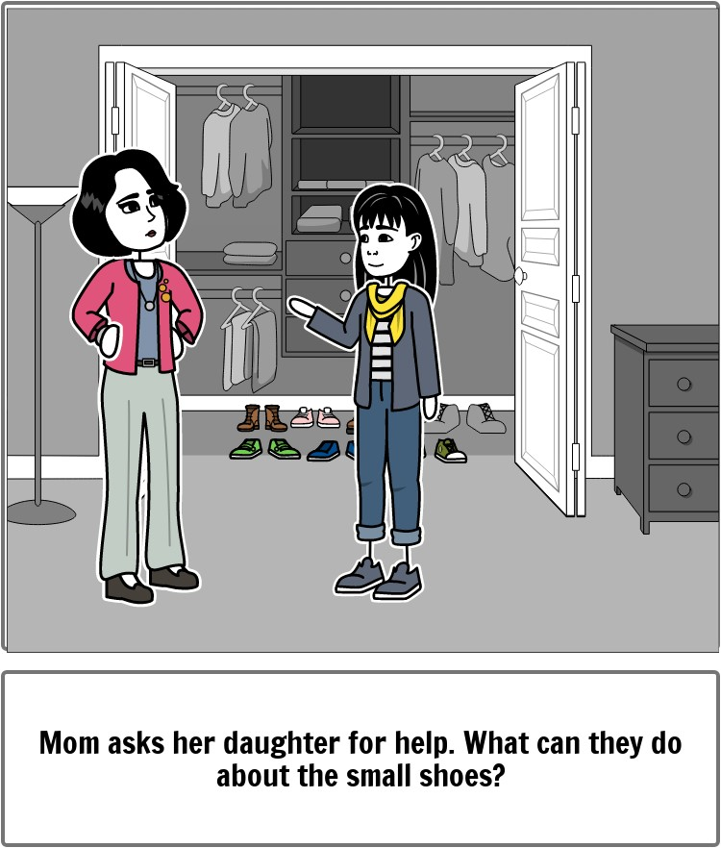
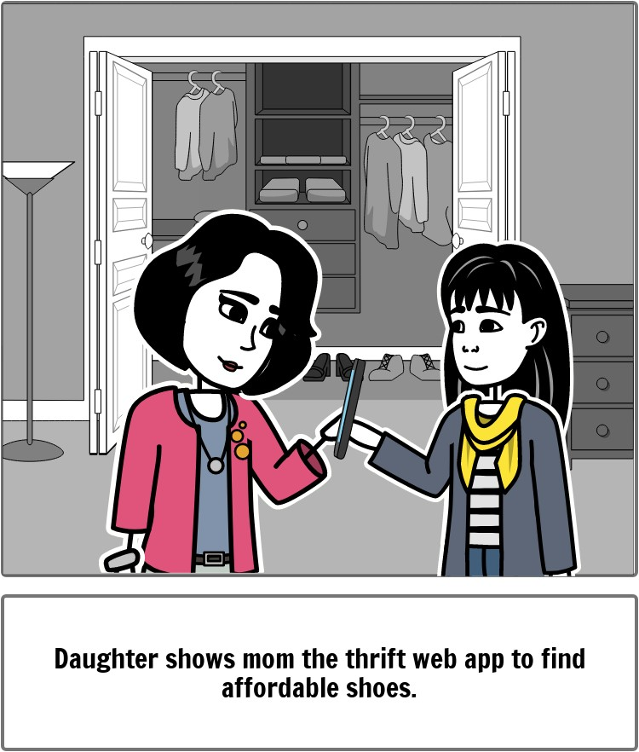

Slide 13
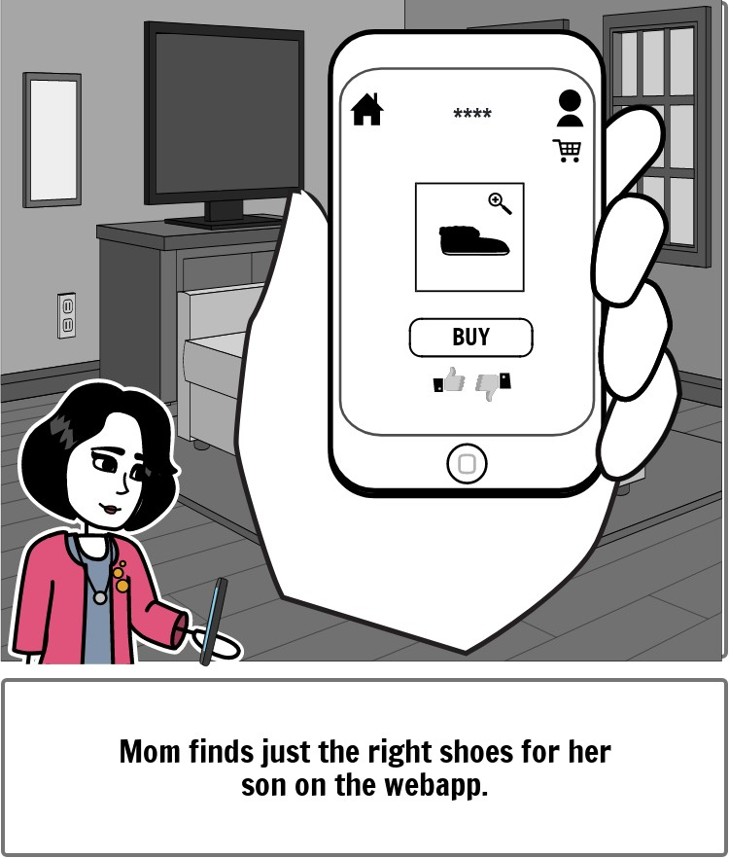
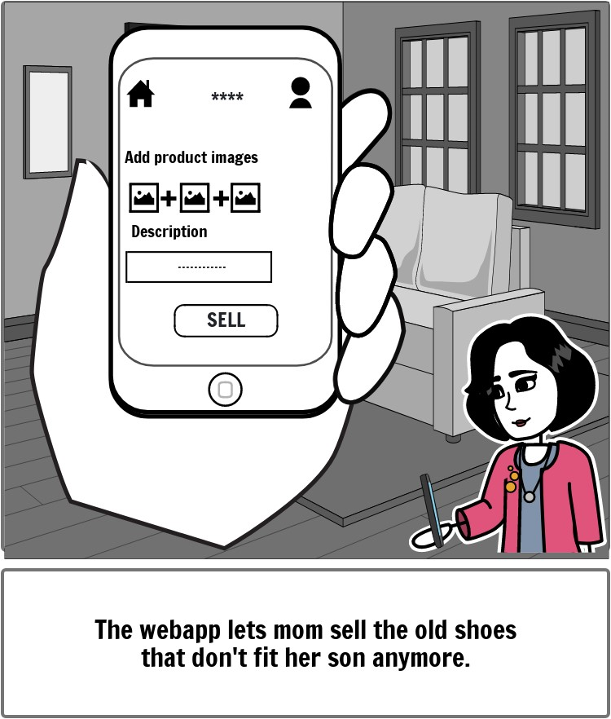

Slide 14
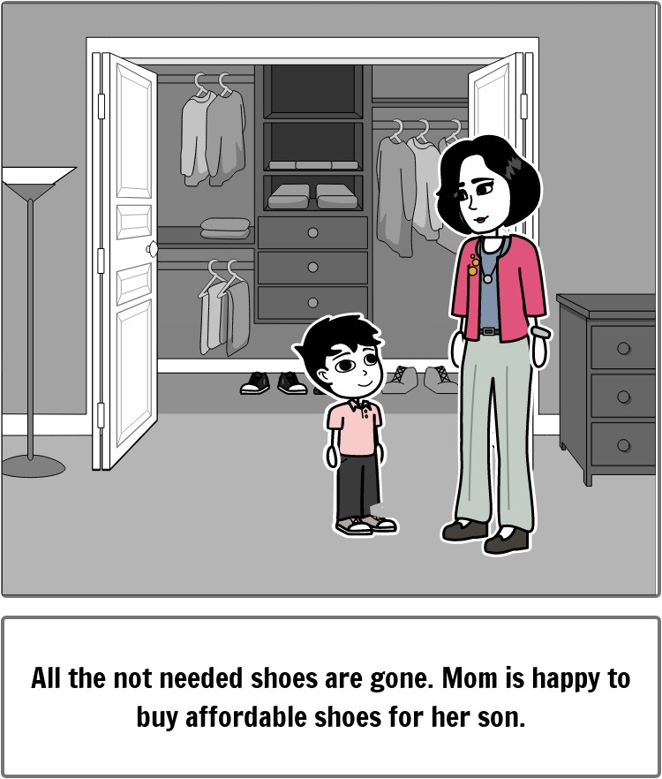

Slide 15
The Fix
Quality control:
offering an image quality detector with low-light and blur sensors to help sellers present high quality images and make sure buyers are able to asses’ items properly
Trust & reliability:
assigning ‘Trusted-Seller’ badges based on reviews and ratings of the sellers to encourage users to shop with confidence

Slide 16
The Fix
Accessibility & Support:
24/7 chatbot for continuous assistance
Adjustable text-sizes and text-to-speech capabilities
Flexibility:
recommendation system enhancing user experience
Price negotiation

Slide 17

Business model
Buying
Selling
Delivery fee
5% platform fee
Delivery
Payment
collaboration
COD & online payment
Donating
collaboration

Slide 18
Cost for development :
Maintenance
Development
Delivery collaboration
Marketing
Unforseen expenses

Slide 19

Technologies
back-end
front-end
SpringBoot/Javascript
Reactjs./Html CSS
Database
Development Process
Mysql
GitHub

Slide 20

Deliverables
A responsive web app that allows users to sell, buy and donate pre-used or second-hand items with ease.
Provides flexibility , reliability , availability & accessibility

Slide 21
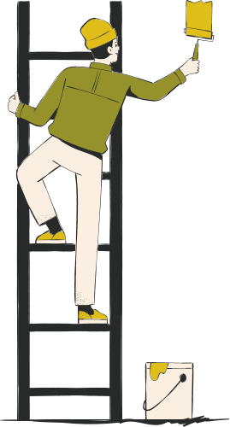
Timeline
FYP - I
1st Quarter
2nd Quarter
3rd Quarter
4th Quarter
Proposal
Requirement analysis
Design
Interim implementation & deployment

Slide 22
Timeline
FYP - II
1st Quarter
2nd Quarter
3rd Quarter
4th Quarter
Implementation
Deployment
User testing & feedback
IImprovements

Slide 23
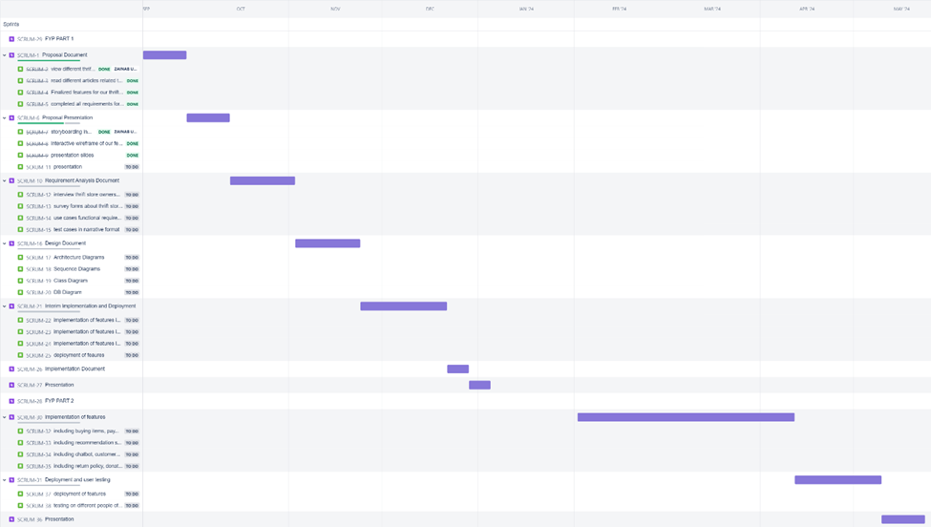

Slide 24

Expertise
Muhammad Danyal
An expert who will be helping us out with technical issues and figuring things out.

Slide 25
Thank you

